Slide 1




Urban Stormwater Harvesting: Implications and Strategies for Detention Basin Soils
Mara Rembelski
Advised by Dr. Craig Rasmussen, Associate Professor of Environmental Pedology
25th Annual Arizona Space Grant Consortium Symposium
16 April 2016
University of Arizona

Slide 2
Research Purpose
Why is water harvesting important?
Direct flow of rainwater toward trees and vegetation
Repurpose water from precipitation events
Increase soil infiltration for groundwater recharge
Necessary to maintain good basin soil quality

Slide 3
Research Questions
How are urban soils responding to change in watershed structure over time?
1. Soil Chemistry
2. Soil Mineralogy
3. Soil Texture
How can these soils be amended to improve local soil and water quality through application of biochar?
Notes:
-The UA has been very progressive in incorporating water-harvesting detention basins within its infrastructure for the past 30 years or so
-The focus of my project was to take a closer look at how the manipulation of our urban watershed is affecting detention basin soils
-I took a quantitative look at how soil chemistry, mineralogy, and texture are changing as a result of an increased influx of stormwater runoff
-I also researched the potential for biochar to be used as a soil amendment to improve local soil and water quality

Slide 4
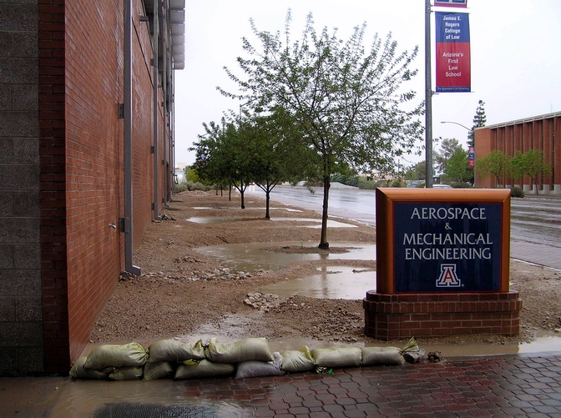
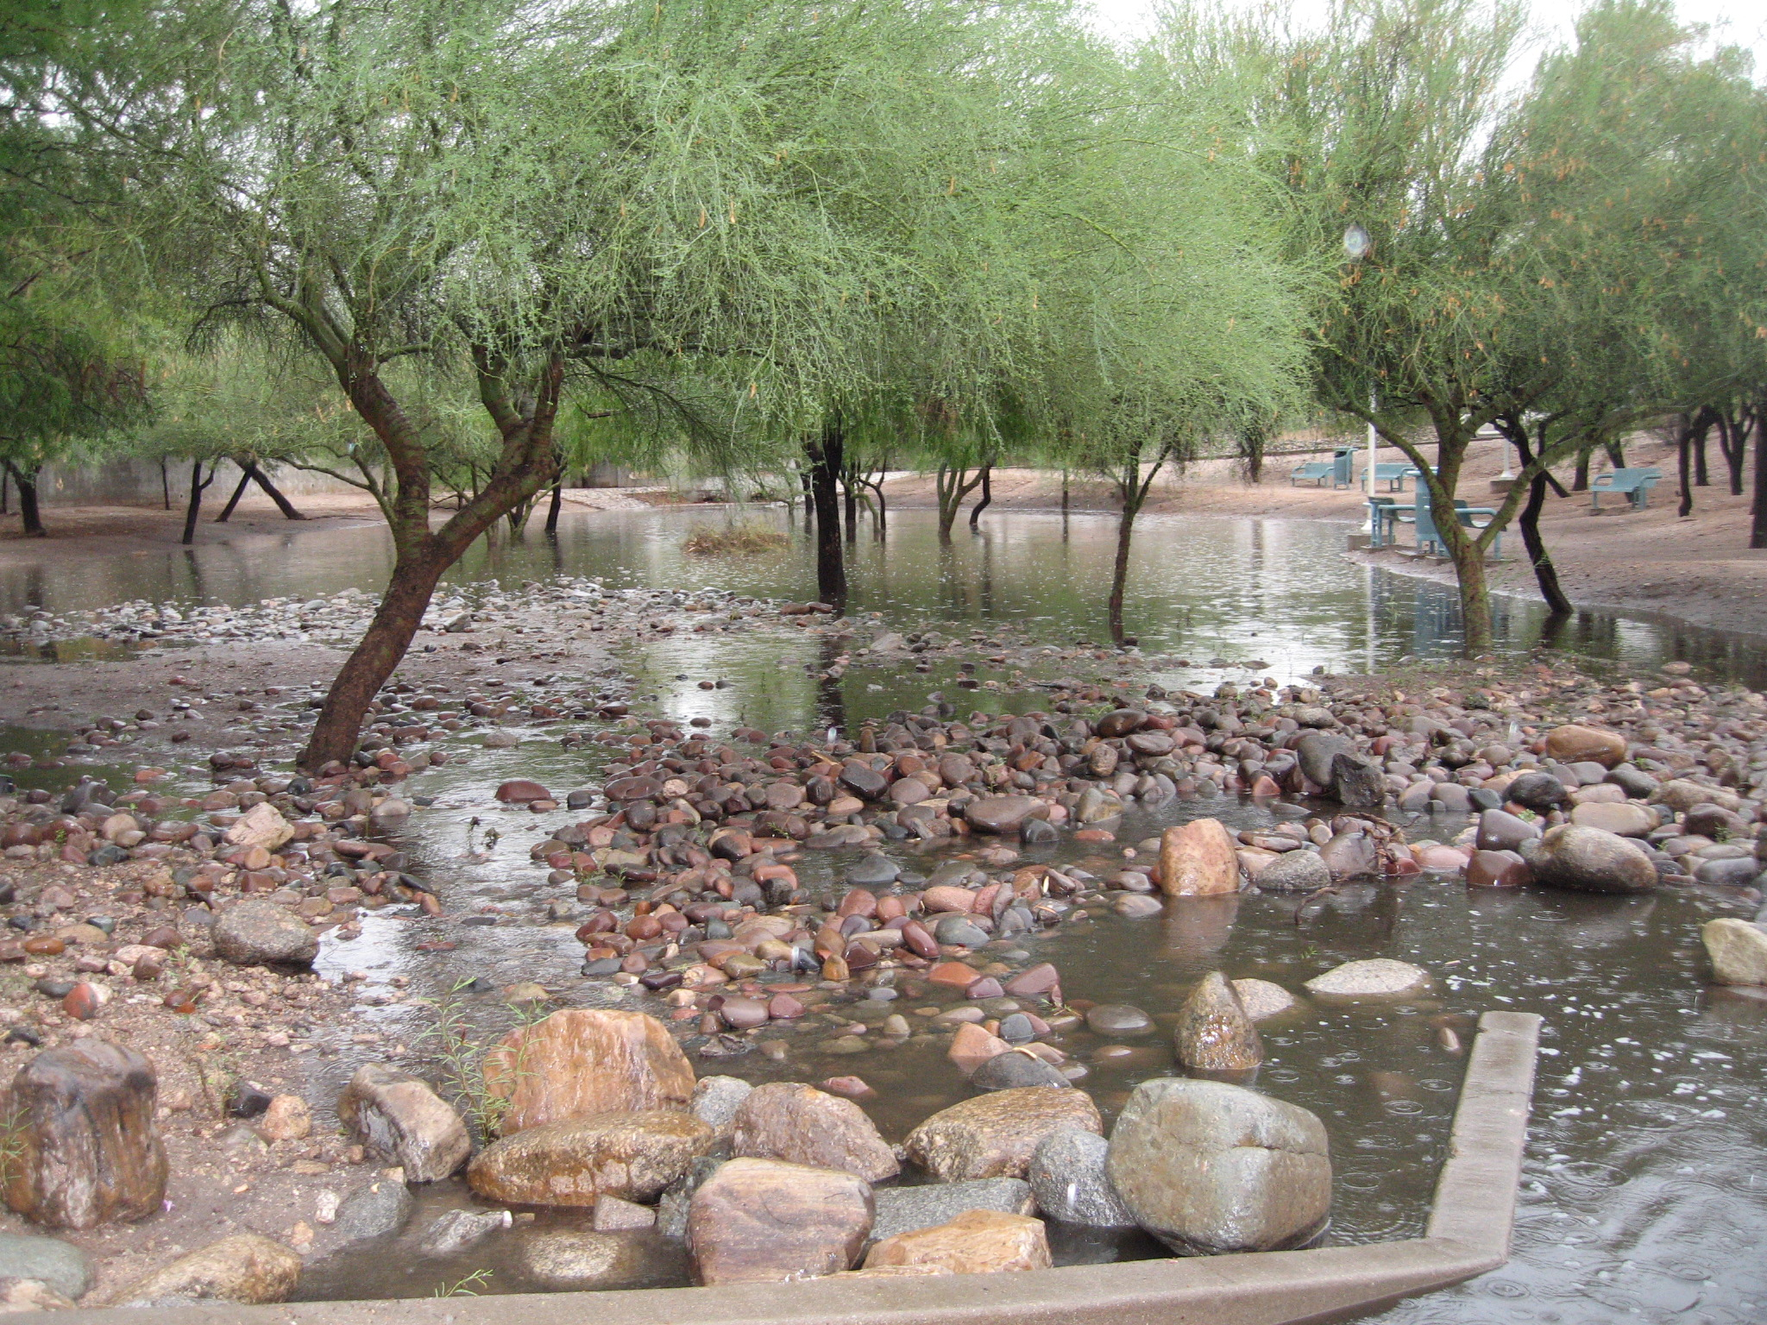
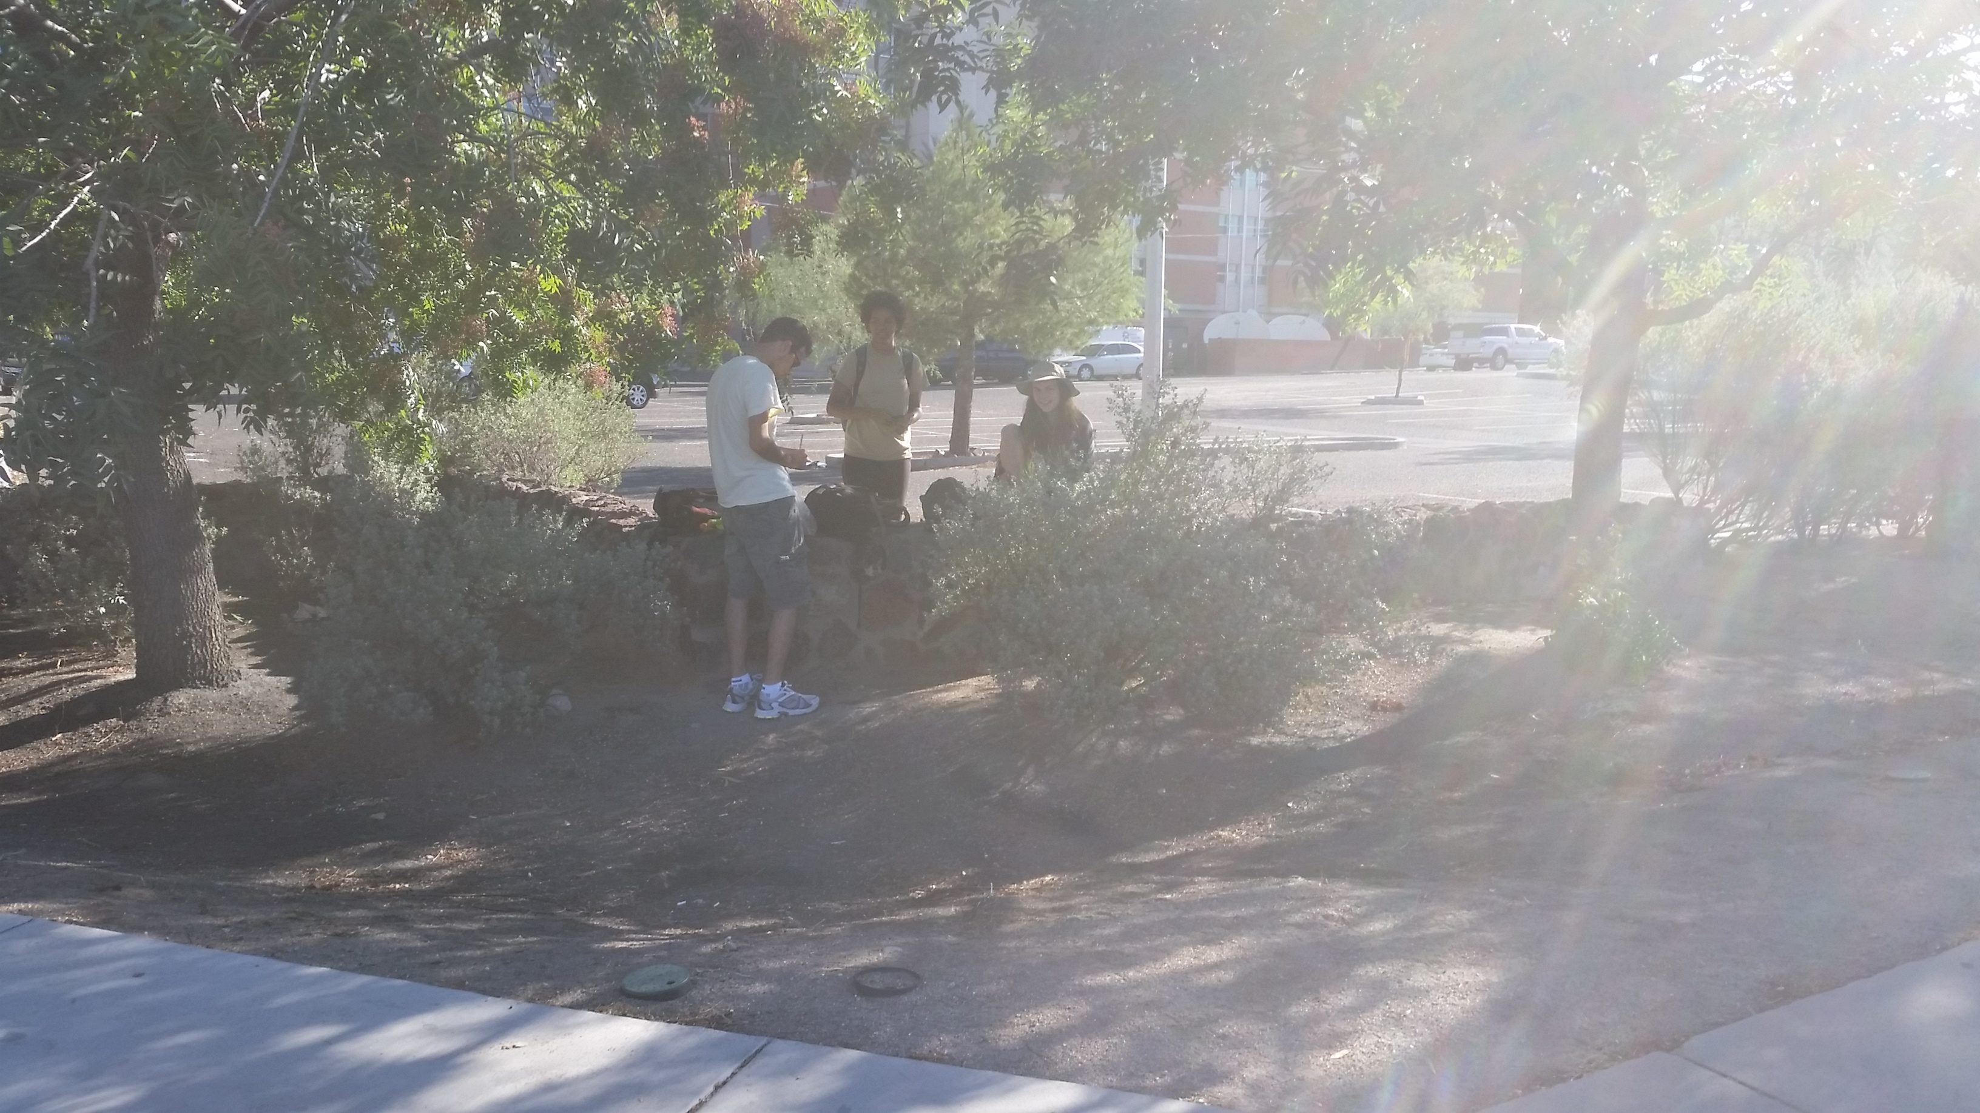
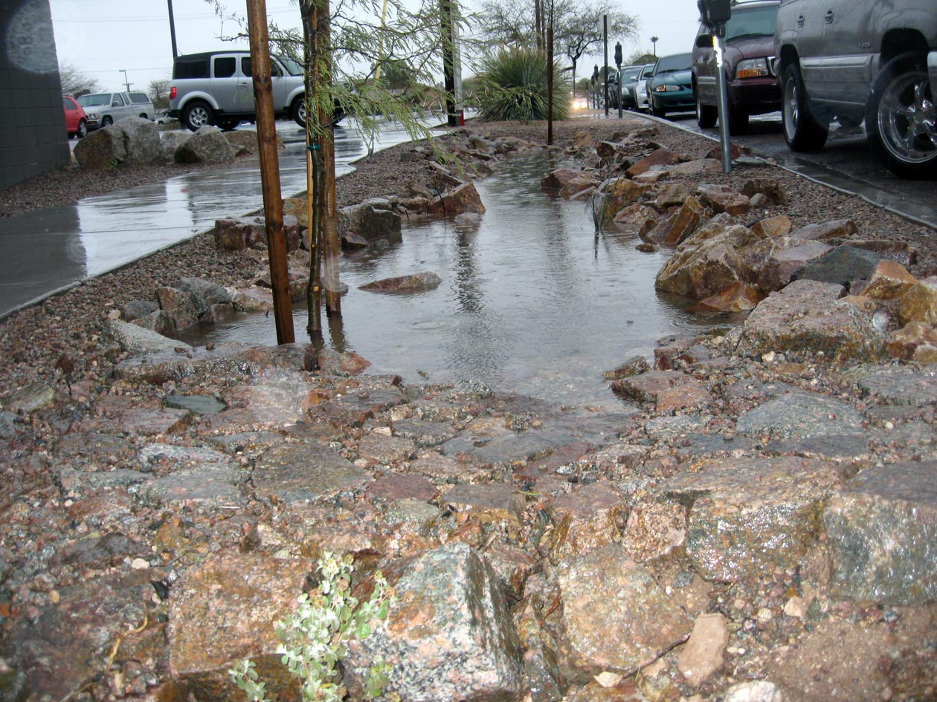
The Four Sampling Basins
AME Basins (constructed 2006)
Nursing Basin (constructed 1992)
Photo Credit: Grant McCormick
Photo Credit: Grant McCormick
Tyndall + 6th Basins (constructed 1996)
Rec Center Basins (constructed 2010)
Photo Credit: Luis Salgado
Photo Credit: Grant McCormick
Notes:
-Four campus basins were selected for study in this project because of their differences in age and location within the overall watershed
-Within each basin, about 6 soil samples were taken from the bottom of the basin receiving the direct influx of stormwater, and 6 samples were taken as control samples from the surrounding soil above the basin
-The four basins sampled are shown here with the year they were constructed… our older basins include the College of Nursin basin and the Tyndall/6th basin

Slide 5
Methods in Analysis of Basin Soils
pH
Electrical Conductivity (EC)
X-Ray Diffraction
X-Ray Fluorescence
Loss on Ignition
Water Holding Capacity
Particle Size Analysis

Slide 6
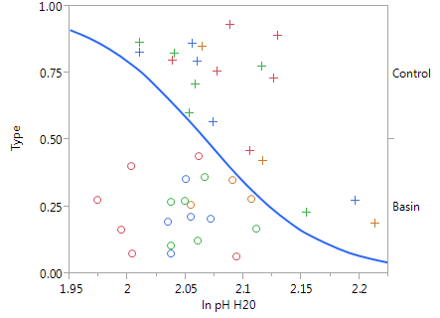
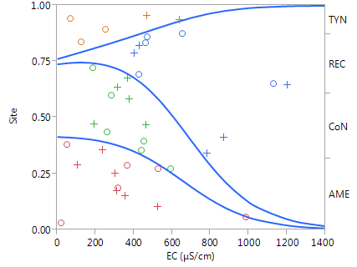
Results: pH and EC Variation
Logistic Fit of Sample Type by ln(pH)
-Statistically Significant p=0.0083
-Basin soils tend to be less basic
Logistic Fit of Site by EC
-Statistically Significant p=0.0069
Basin (o) Control (+)
Tyndall, Rec Center, Nursing, AME

Slide 7
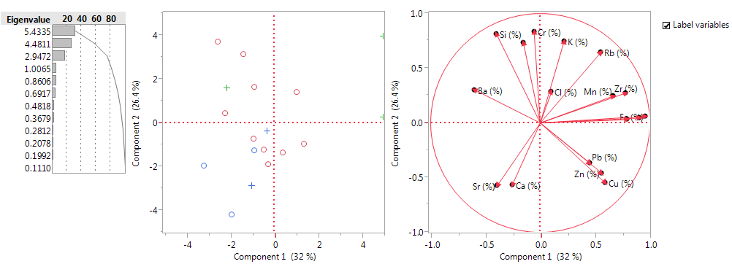
Results: Multivariate XRF Analysis
Elemental Variation Statically Significant by Basin Site
-Ca (p<0.0001)
-Zr (p<0.0001)
-Sr (p<0.0001)
-Fe (p<0.0001)
-Cr (p=0.0005)
-V (p=0.0008)
-Cu(p=0.0012)

Slide 8
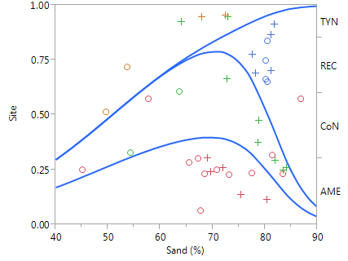
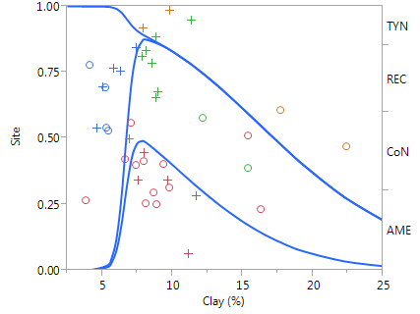
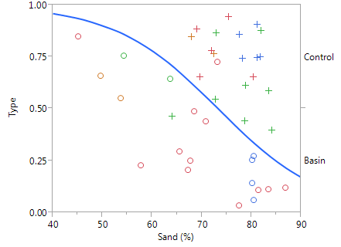
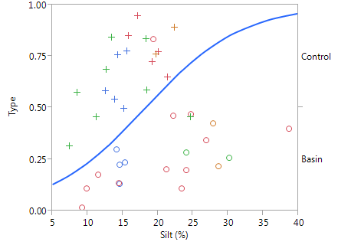
Results: Particle Size Analysis
Logarithmic Fit of Site by Sand (p=0.0006)
Logarithmic Fit of Site by Clay (p<0.0001)
Logarithmic Fit of Type by Sand (p=0.0104)
Logarithmic Fit of Type by Silt (p=0.0088)
Basin (o) Control (+)
Tyndall, Rec Center, Nursing, AME

Slide 9
Soil Amendment: The Benefits of Biochar
Biochar is formed through pyrolysis of biomass
Urban runoff inherently contains many different organic compounds present in gasoline, diesel, oil, herbicides, pesticides
Biochar has an affinity for absorbing these organic contaminants including benzene, atrazine, trichloroethylene (TCE)
Notes:
-Biochar is a common soil amendment that is comprised of biomass that has undergone pyrolysis
-It has been shown to have a particular affinity for absorbing organic contaminants such as benzene, atrazine, TCE
-These types of contaminants are abundant in urban stormwater runoff from oil, pesticides, herbicides

Slide 10
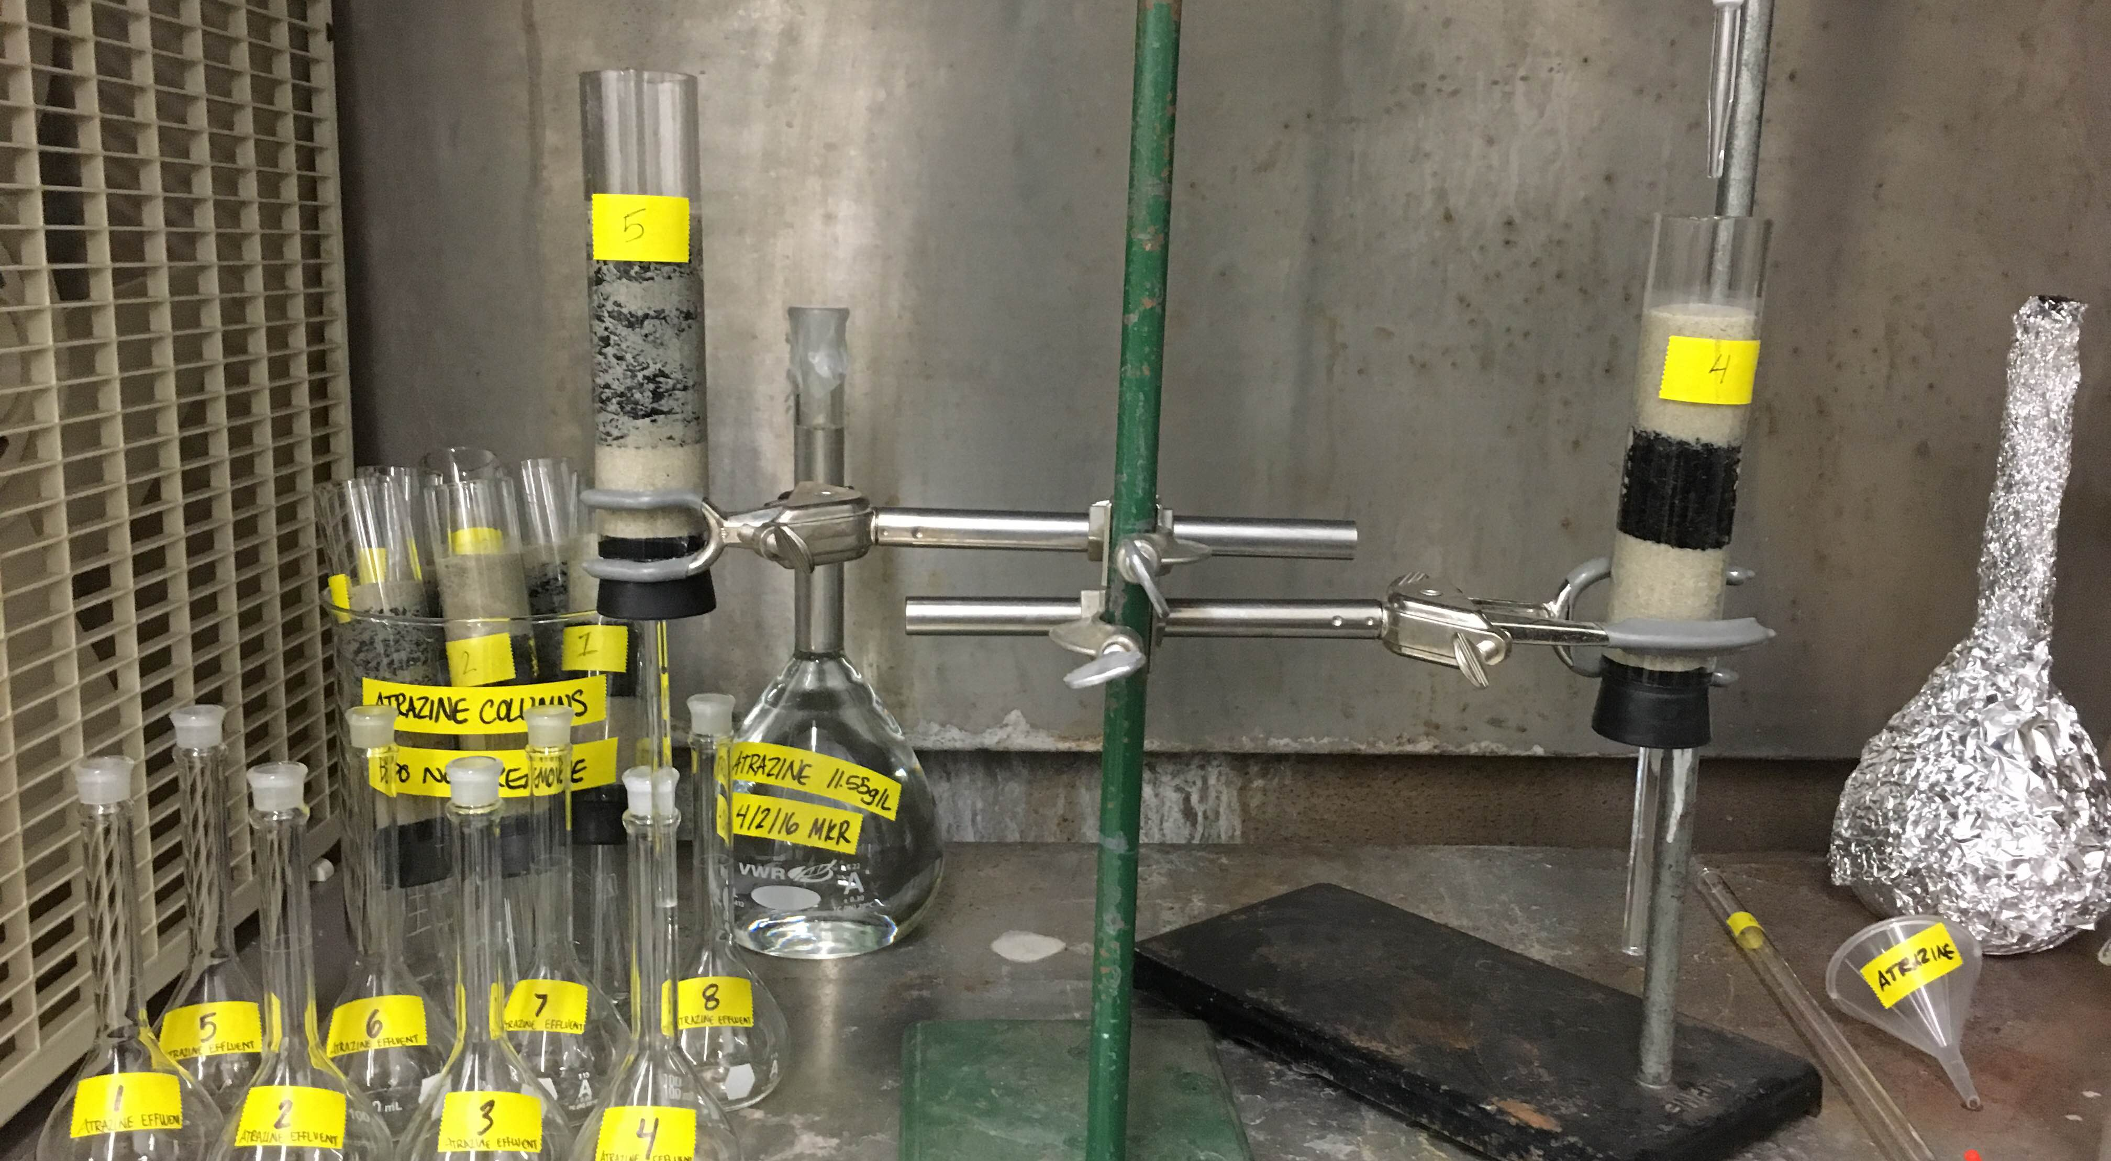
Biochar Column Experiment

Slide 11
Conclusions
Variability in soil properties between different basin sites and basin/control samples
Over time, these soils accumulate components from surface runoff
Biochar is an and effective means of improving water and soil quality within detention basins

Slide 12
Acknowledgements
NASA Arizona Space Grant Consortium, Susan Brew and Chandra Holifield
My Advisor Dr. Craig Rasmussen
Professors Dr. Janick Artiola and Dr. Erika Gallo
Grant McCormick, UA Campus Planner

Slide 13
Thank You

